Slide 1
Html
MCNDHS
Ms. Eng

Slide 2
aim: how do we save images to our repository by using images taken from our cellphones?
Do now:
take out YOUR laptop! Open up your repository folder and listen to my instructions!
Daily Grade:
On-time/attendance/not leaving the classroom: 25%
Cellphones: 25%
Notes:25%
Classwork/Homework: 25%

Slide 3
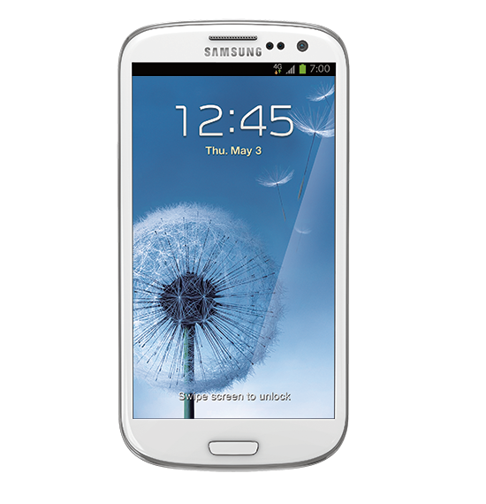
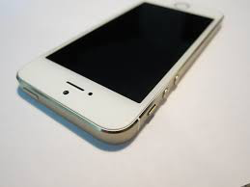
step 1:
take out your phone.

Slide 4
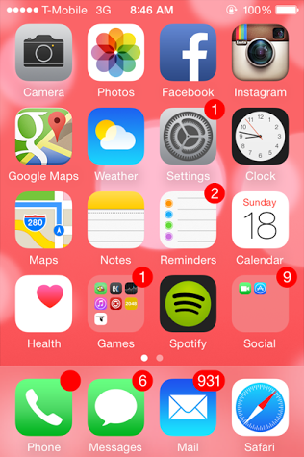
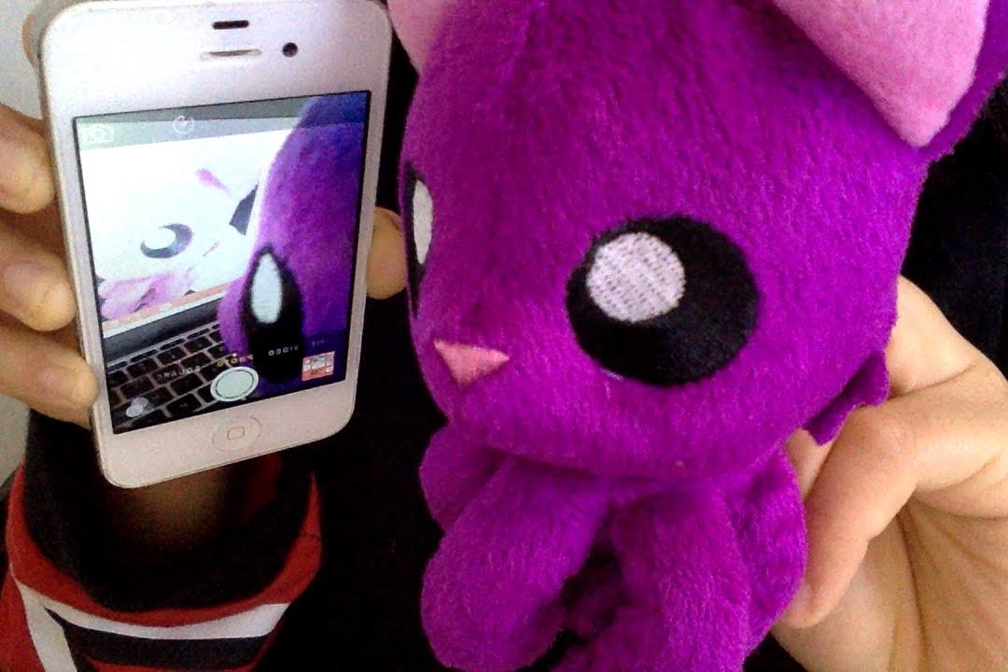
step 2:
take a selfie (definition: a picture of yourself)

Slide 5
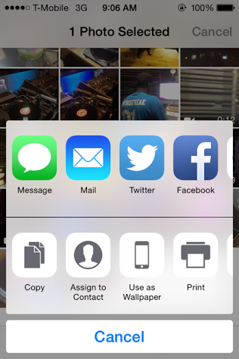
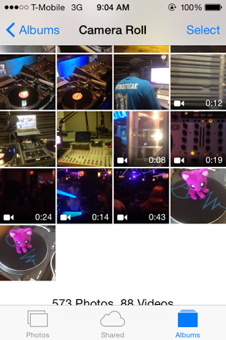
step 3:
E-mail the picture to yourself

Slide 6
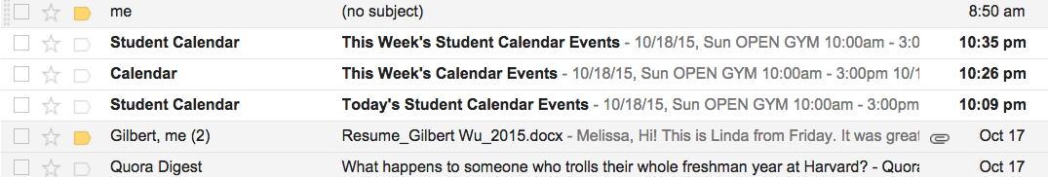
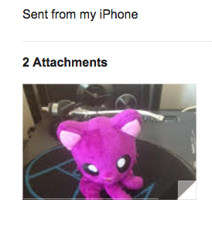
step 4:
open your email from your computer:

Slide 7
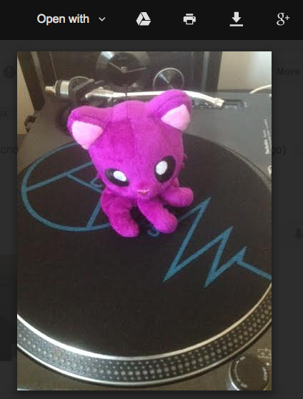


Step 5: Download the image and rename

Slide 8
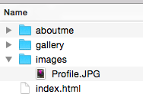
final step:
MAKE SURE YOUR IMAGE IS INSIDE YOUR IMAGES FOLDER inside your REPOSITORY!

Slide 9
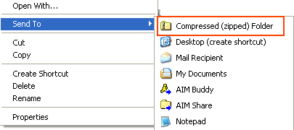
double check safety:
compress your repository folder.
Right click on the folder and click compressed zipped

